Slide 1
NutriDesh
নিউট্রিদেশ
AI-powered nutrition for Bangladesh. In Bangla. For Bangladeshi food.
CloudCamp 2026
Healthcare Track
100% Free Stack
NutriDesh · CloudCamp Bangladesh 2026
1 / 12
Notes:
NutriDesh. A Bangla-first AI nutrition companion built for Bangladesh.

Slide 2
The crisis hiding in plain sight
Bangladesh's double burden of malnutrition
24%
11%
35%
170M
of children
under 5 stunted
of adults
living with diabetes
of women now
overweight or obese
people, zero apps
that speak their food
Every nutrition app is built for Western diets. None speak Bangla. None know dal-bhat-ilish.
NutriDesh · CloudCamp Bangladesh 2026
2 / 12
Notes:
> Bangladesh carries a double burden of malnutrition. Twenty-four percent of children are stunted. Eleven percent of adults are diabetic. Thirty-five percent of women are now overweight — up from eleven percent two decades ago.
> And yet — for a hundred and seventy million people who live on dal-bhat, ilish, and khichuri — there is not a single nutrition app that speaks Bangla or recognizes a single deshi dish. Every app on the market is English, Western, and useless here.
> This is a 170-million-user gap nobody has built for

Slide 3
Meet NutriDesh
A nutrition companion built Bangladeshi from the ground up
1
2
3
Understands your food
Speaks your language
Knows your life
AI vision trained on hilsa, khichuri, dal, pui shak, shutki — not pasta and quinoa.
Every screen, every alert, every chat response — in Bangla first. Hind Siliguri throughout.
Bazaar prices, Ramadan timings, diabetic dal recipes, pregnancy by gestational week.
Not a Western app translated. A Bangladeshi app, designed first.
NutriDesh · CloudCamp Bangladesh 2026
3 / 12
Notes:
> NutriDesh closes that gap. Three principles.
> One — it understands deshi food. AI vision tuned for hilsa, khichuri, dal, pui shak, shutki — not pasta and quinoa.
> Two — it speaks Bangla. Every screen, every alert, every AI response — in Bangla first, with text-to-speech for low-literacy and elderly users.
> Three — it knows your life. Bazaar prices. Ramadan timings. Diabetic recipes. Pregnancy by gestational week. WHO stunting checks for children.
> Not a Western app translated. A Bangladeshi app, designed first.

Slide 4
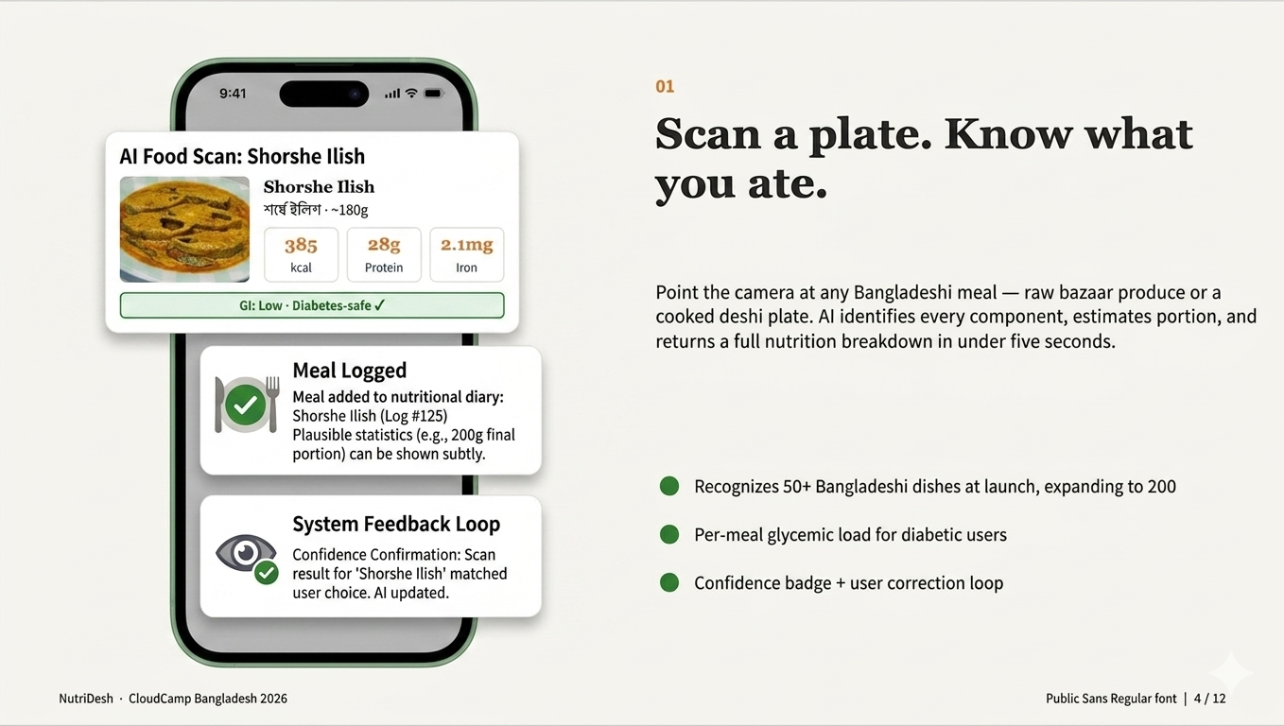
Notes:
> Here is how it works. A user points their phone at any deshi plate — raw, cooked, or mixed.
> The image goes to Gemini Flash multimodal vision, which identifies each component in Bangla and English, estimates portion size, and returns a structured nutrition card pulled from our curated Bangladeshi food database.
> Three seconds, end to end.

Slide 5
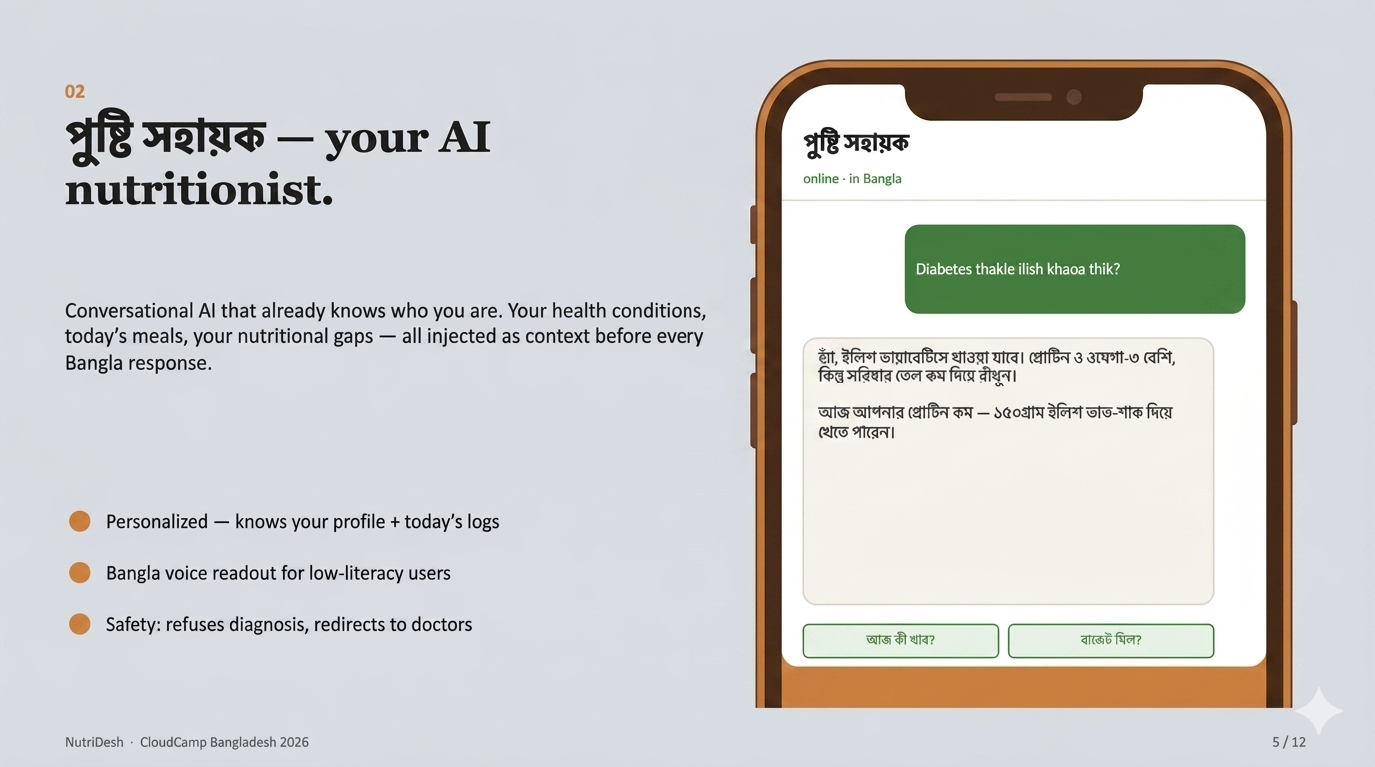
Notes:
> The user logs the meal and can ask the AI assistant anything — in Bangla. *"ডায়াবেটিসে ইলিশ খাওয়া যাবে?"*
> The assistant knows the user's profile, medical conditions, and every meal logged today. The response is contextual, not generic — grounded in BIRDEM, FAO, and WHO guidelin

Slide 6
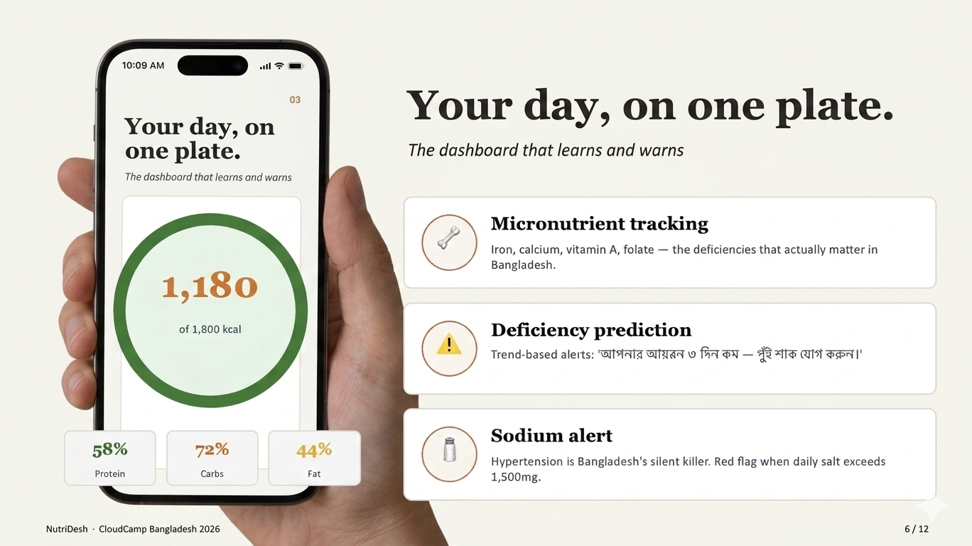
Notes:
> All of it rolls up to a daily dashboard. Calories, macros, key micronutrients against Bangladeshi RDA values, deficiency alerts, and a sodium warning if salt creeps past clinical thresholds.

Slide 7
We didn't stop at MVP.
Specialized modes for the populations that need them most
🩺
🤱
👶
Diabetes Mode
Pregnancy Mode
Child Profile
GI traffic light per meal, glucose log, sodium alerts.
Gestational week tracking, trimester-specific targets.
WHO growth standards, stunting & underweight assessment.
🌙
🏥
💰
Ramadan Mode
Shastho Shebika Portal
Budget Meal Planner
Sehri/Iftar guidance, hydration tracker, diabetic-safe.
PIN-locked roster, PDF reports for community health workers.
৳150 input → nutritious meals at bazaar prices.
NutriDesh · CloudCamp Bangladesh 2026
7 / 12
Notes:
> Plus six specialized modes — diabetes, pregnancy, child growth, Ramadan, Shastho Shebika portal, and bazaar budget meals.

Slide 8
Built on a 100% free stack.
Zero paid APIs. Zero hosting bills. Production-ready.
Mobile
Expo React Native
iOS + Android, one codebase, QR demo
AI Engine
Gemini Flash (latest)
Unified: food vision + Bangla chat + recs
Backend
Node.js + Express
Hosted free on Render with keep-alive ping
Storage
AsyncStorage
Local-first cache, offline-capable
Deploy
Expo Web + EAS
Live web app + Android APK with OTA updates
Total infrastructure cost at hackathon scale: ৳0 / $0
NutriDesh · CloudCamp Bangladesh 2026
8 / 12
Notes:
Now the AI thinking.
> One model, three jobs. Gemini Flash powers food vision, Bangla conversation, and budget meal recommendations. We force structured JSON output via `responseSchema` so the model cannot hallucinate free text.
>
> Context injection on every chat call. User profile, conditions, calorie target, today's nutrients, last ten messages — all passed as system instructions. That is why the assistant gives diabetic-aware answers, not generic LLM advice.
>
> RAG-style enrichment. Gemini identifies the food; our local Bangladeshi food database supplies trusted FAO and BIRDEM nutrition values. AI for perception, structured data for facts.
>
> Caching plus rate limit. Server-side cache with thirty-day TTL, pre-seeded for fifty common dishes. Free tier handles fifteen hundred requests per day.
>
> Total infrastructure cost — zero taka, zero dollars.

Slide 9
Why this is different.
NutriDesh vs. every nutrition app you've seen
Every other app
NutriDesh
✗
English-only interface
✓
Bangla-first throughout, English toggle
✗
Western foods: pasta, quinoa, smoothies
✓
Hilsa, khichuri, dal, pui shak — native
✗
Restaurant or gym-culture focused
✓
Household + bazaar + Ramadan grounded
✗
Generic global recommendations
✓
Personalized to your conditions + budget
✗
No idea what shutki or pui shak is
✓
50+ BD foods, 200 roadmap, growing
✗
Ignores Bangladesh's price reality
✓
৳150 budget mode, bazaar price table
NutriDesh · CloudCamp Bangladesh 2026
9 / 12
Notes:
Every other nutrition app fails on Bangla, fails on deshi food, fails on bazaar reality. NutriDesh is the inverse.

Slide 10
Built for who needs it most.
Five Bangladeshis who get NutriDesh — and what changes for them
Household manager
Knows if family meals meet daily nutrition needs — at bazaar prices.
Diabetic patient
Glycemic load on every plate. Doctor-shareable weekly report.
Pregnant mother
Week-by-week guidance for folate, iron, calcium needs.
Parent of young child
WHO growth tracking, stunting risk alerts, deshi food recipes.
Shastho Shebika
PIN portal to manage village families, PDF clinical reports.
NutriDesh · CloudCamp Bangladesh 2026
10 / 12
Notes:
> Five users get NutriDesh.
>
> Household managers planning family meals on tight budgets. Diabetic patients tracking glycemic load. Pregnant mothers needing folate by gestational week. Parents tracking child stunting. Shastho Shebikas managing entire villages.

Slide 11
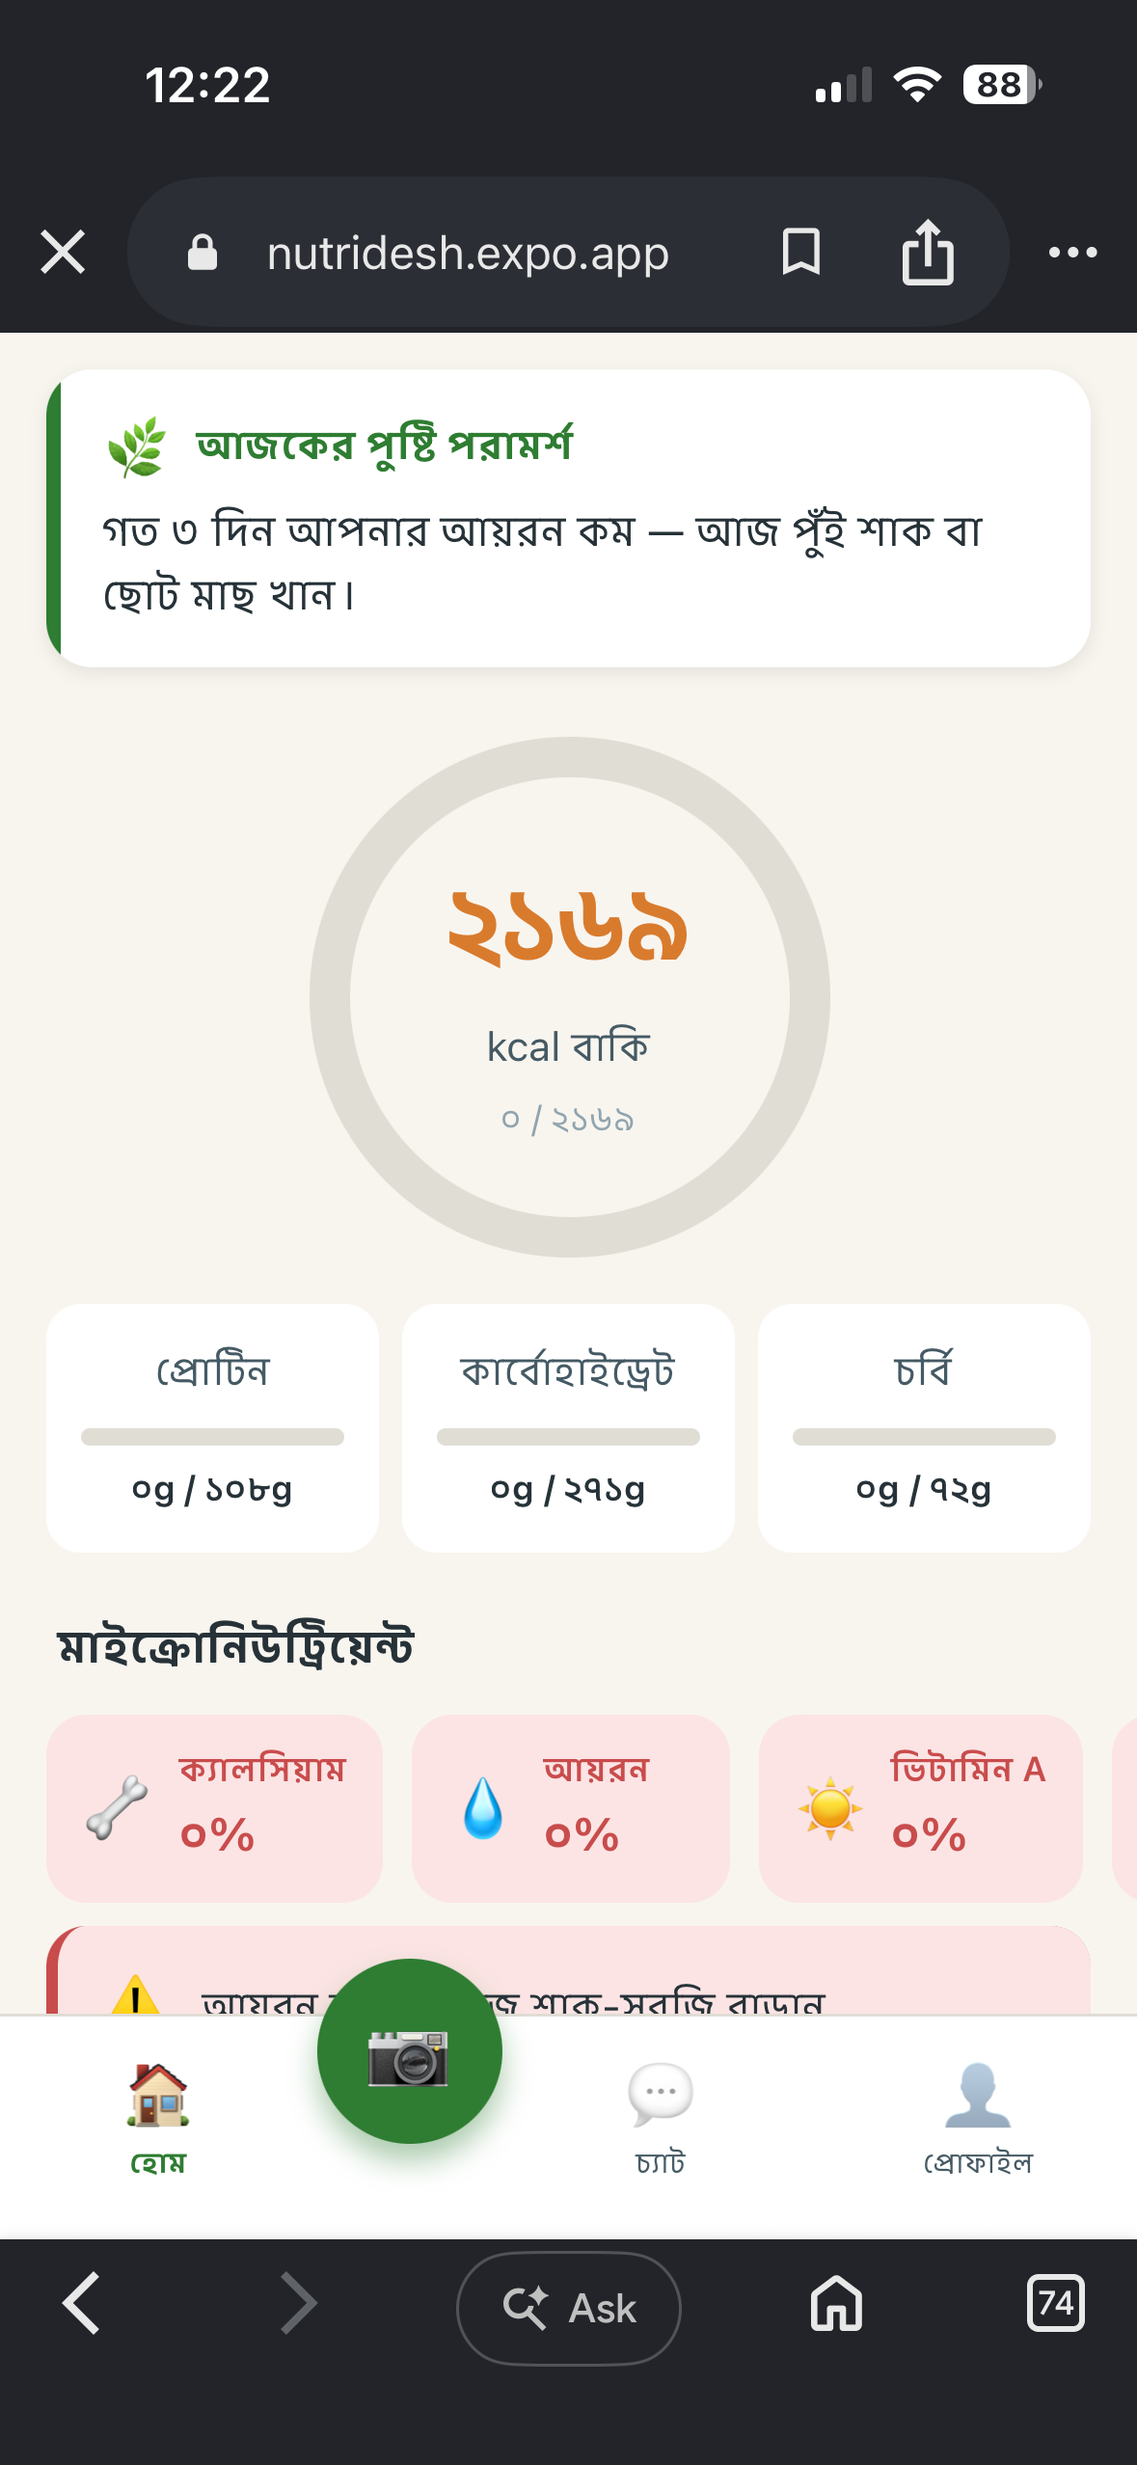
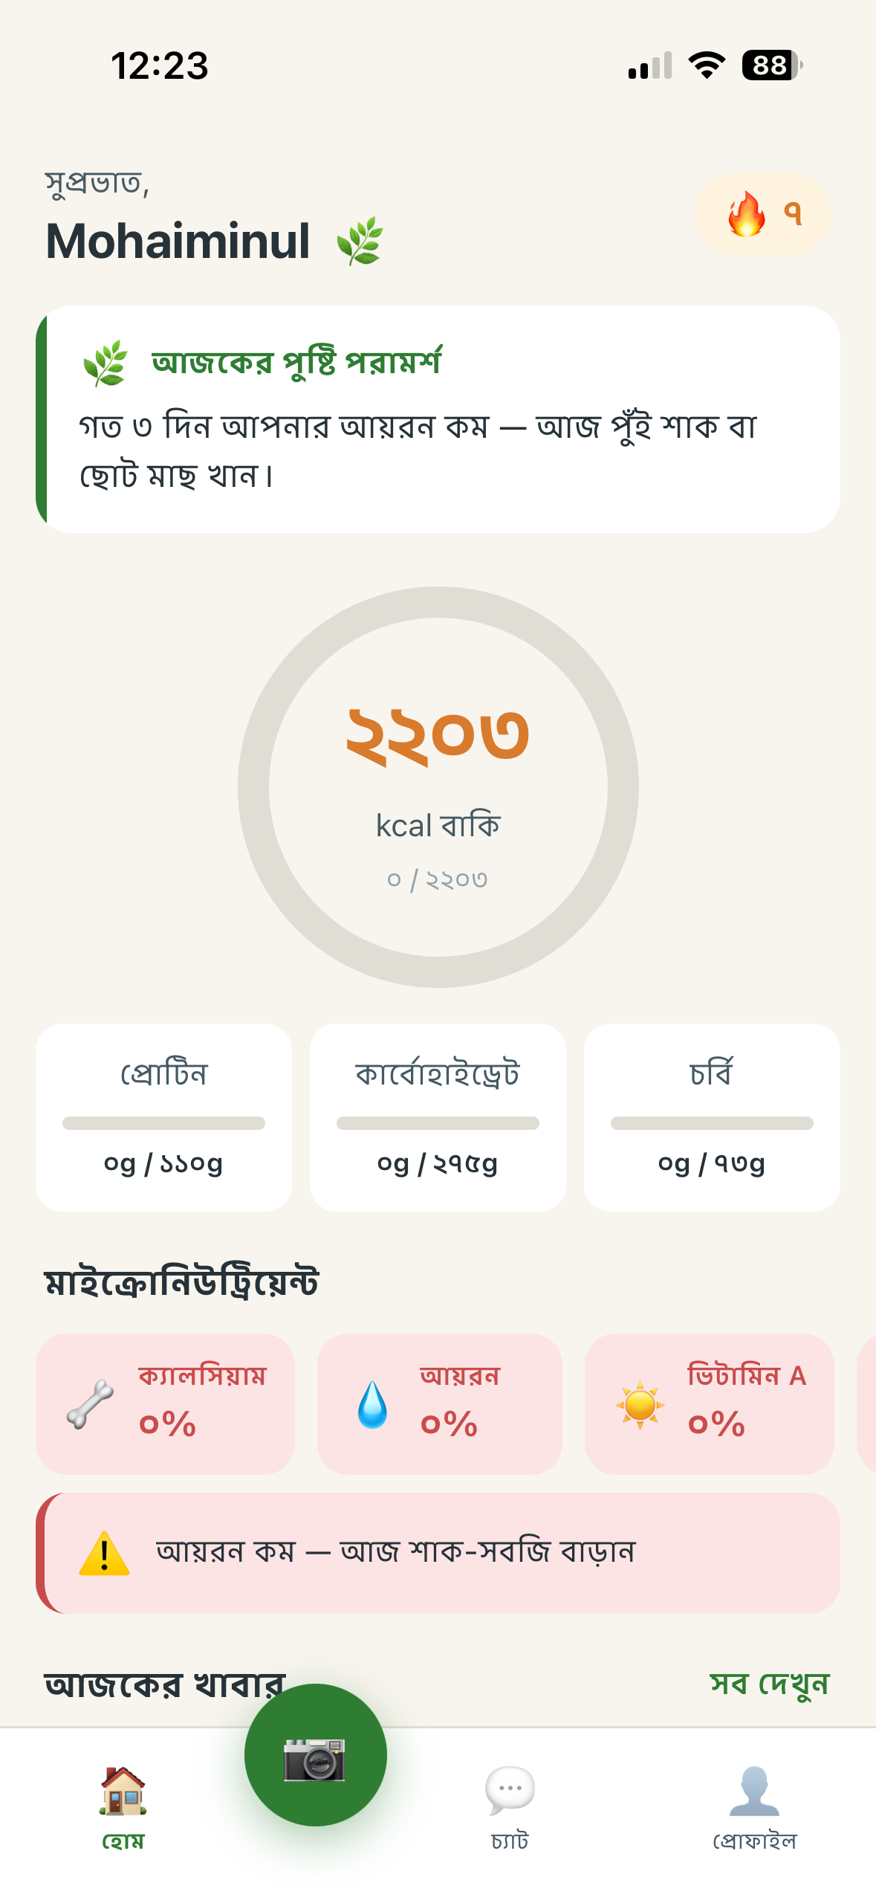
Already live. Already shipped.
This isn't a pitch deck — it's a working product
🌐
Live Web App
nutridesh.expo.app
Try it right now. Open on any phone or laptop. No install needed.
📱
Android APK
Built with EAS · OTA updates ready
Native APK shipped through Expo Application Services. Live update channel configured — ship fixes without re-installs.
• Fine-tuned EfficientNet on 5K BD food images
• Supabase cloud sync + family dashboards
• icddr,b + BIRDEM clinical validation
• Play Store launch
Roadmap →
NutriDesh · CloudCamp Bangladesh 2026
11 / 12
Notes:
> And this isn't a deck — the product is live. Web app on `nutridesh.expo.app` — judges can open it right now, no install. Android APK shipped through Expo Application Services. Backend on Render. OTA update channel configured.
>
> Next steps: a fine-tuned EfficientNet classifier on a five-thousand-image Bengali food corpus for offline scan. Supabase cloud sync. icddr,b and BIRDEM clinical validation. Play Store launch.

Slide 12

Nutrition intelligence
for every Bangladeshi household.
In their language. With their food. At their budget.
nutridesh.expo.app
Healthcare · CloudCamp
Built by 5 CSE students
NutriDesh · নিউট্রিদেশ · May 2026
NutriDesh · CloudCamp Bangladesh 2026
12 / 12
Notes:
> Nutrition intelligence for every Bangladeshi household. In their language. With their food. At their budget.
>
> **নিউট্রিদেশ. পুষ্টি, সবার জন্য.**

